Slide 1
Supporting SAIs in Auditing SDGs
Reflections and Plans

Slide 2
SAIs in make a difference through high quality audits of SDGs
Partnerships : INTOSAI Knowledge Sharing Committee (KSC), INTOSAI General Secretariat, INTOSAI Chair (SAI UAE & SAI Russia), INTOSAI Regions, UNDESA, CAAF, IBP, P4R
In kind contributions : SAIs of USA, Belize, Benin, Bhutan, Brazil, Burkina Faso, Cameron, Colombia, Costa Rica, Gabon, India, Indonesia, Macedonia, Malawi, Malaysia, Paraguay, Peru, Philippines, Papua New Guinea, Saint Lucia, Samoa, Tonga, Argentina, China, Djibouti, Fiji, Senegal
Funding Partners : SAIs of Saudi Arabia, Norway, Swedish International Development Agency, Global Affairs Canada, Ministry of Foreign Affairs of Estonia, BMZ Germany ( via GIZ)

Slide 3
The story so far
Audit of Preparedness for implementation of SDGs
Audit of SDG implementation

Slide 4
Performance Audit of Preparedness for Implementation of SDGs
73 SAIs and one subnational audit office supported

Slide 5
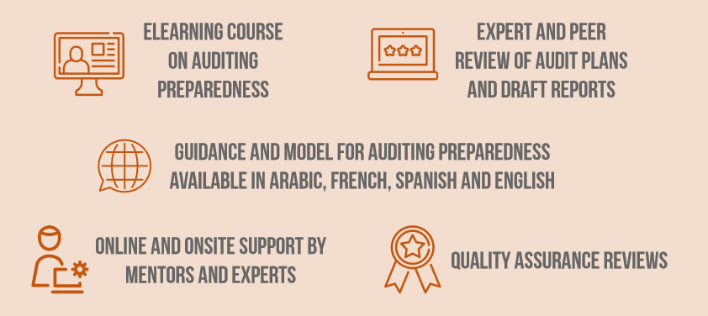

Slide 6
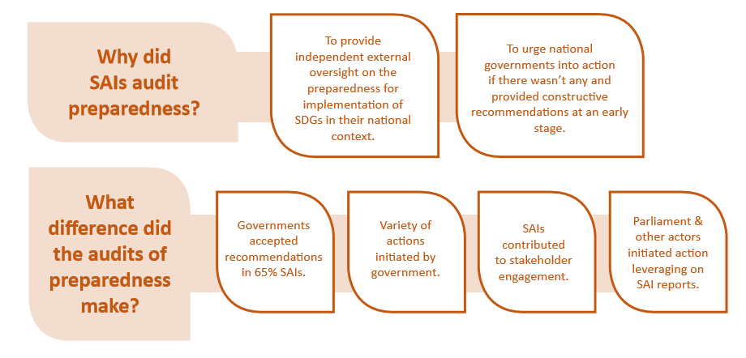

Slide 7
Lessons Learned

Slide 8
IDI’s SDG Audit Model
( ISAM)
Pilot Audits of nationally agreed targets linked to SDG 5.2
Selecting SDG Audit Portfolios
Cooperative Audits of SDG implementation
Facilitate Audit Impact

Slide 9
IDI’s SDGs Audit Model ISAM

Slide 10
Audit of SDG Implementation
The audit of SDG implementation needs to conclude on:
• progress made towards the achievement of the nationally agreed target;
• how likely the target is to be achieved based on current trends;
• the adequacy of the national target in comparison with the corresponding SDG target(s).
“Audit of implementation of the set of policies that contribute to the achievement of a nationally agreed target linked with one or more SDG targets.”

Slide 11
Audit of SDG Implementation
The audit of SDG implementation needs to conclude on the extent of coherence and integration in the implementation of policies.
To the extent possible, the audit of SDG implementation could include objectives and questions that allow to conclude on
• inclusiveness;
• multi stakeholder engagement.
The audit of SDG implementation needs to be planned and conducted considering a whole-of-government approach.
“Audit of implementation of the set of policies that contribute to the achievement of a nationally agreed target linked with one or more SDG targets.”

Slide 12
Selecting the portfolio of audits of SDG Implementation
Significance
Auditability
SAI Mandate
Audit Impact
Audit capacities
Identify nationally agreed targets
Analyse targets using agreed criteria
Select a multi year portfolio of targets to be audited
Review portfolio every year
Include SDG Implementation Audits in annual plan
Check link with SDG targets
Criteria for selection
ISSAI 3000/90-91

Slide 13
Audit of SDG Implementation – The Process
Plan
Conduct
Report
Follow up
Nationally agreed targets, performance indicators, coherence,
WoG, Stakeholder Engagement, inclusiveness
Documentation, Quality Management, Ethics, Communication

Slide 14
Faciltate Audit Impact
Communicate key messages
Strengthen follow up mechanism
Create coalitions

